Slide 1
WELCOME
Beyond Barriers
Leadership Development Programme
Launch Event
East Midlands Children’s Services Leadership Development Programme 2025/26

Slide 2
Agenda
9.30am
Registration & Refreshments
10.00- 10.45am
Welcome and Keynote- Jane Moore
10.45- 11.00am
360 Evaluation Tool
11.00am
Break
11.15- 12.00pm
Mentoring Arrangements-
Kate McKenna
12.00- 12.45pm
Introductions to Group Tasks – Pete Chilvers
12.45pm
Questions and answers
1.00pm
Lunch and Close
2.00- 4.30pm
Mentor Training Session 2
(Mentors only)

Slide 3
The Beyond Barriers Programme
The ambition for the region
The ambition for leadership
Welcome!

Slide 4
Programme Objectives
Equip participants with leadership competencies specifically designed to address their distinct challenges and leverage their individual strengths.
Enhance the understanding of cultural competence among leaders in children’s services to effectively confront racism, intersectionality, and systemic inequalities at both personal and organisational levels.
Foster the development of networks and support systems for leaders from diverse backgrounds.
Improve confidence, visibility, and preparedness for senior leadership positions.
Formulate actionable leadership strategies for both individuals and organisations.

Slide 6
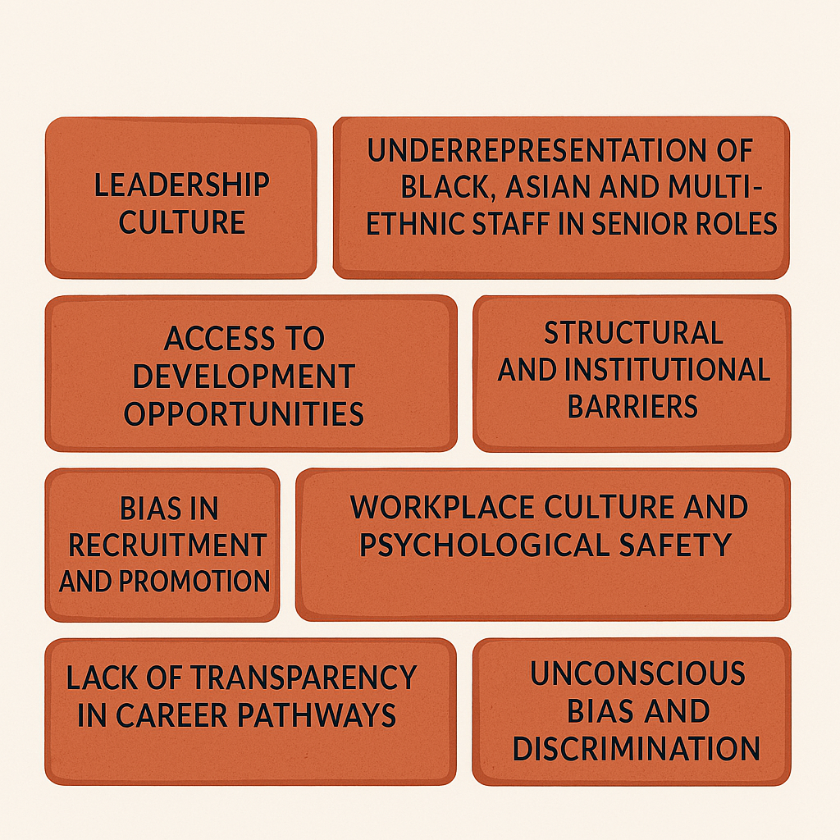
Barriers to Progression

Slide 7
Leadership in Children’s Services
Balancing
Wicked issues
Regulation and inspection
Opportunities
Risk
Volatility, uncertainty, complexity, ambiguity
Increasing demand and responsibilities
Decreasing resources

Slide 8
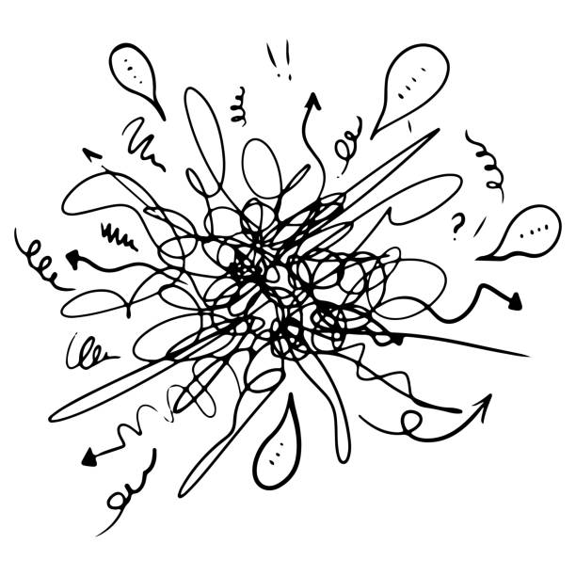

Slide 9
Beyond BarriersLeadership development
Strategic Senior roles in CFS

Slide 10
Leadership Qualities
Personal Qualities
Working and Leading Colleagues
Working with uncertainty and complexity
Working with partners
Leading improvement

Slide 11
Personal Qualities
Is open, honest and driven by a string moral purpose
Has personal resilience, tenacity and humour
Has a strong sense of self and an openness to possibilities
Has both the confidence and humility to seek out and utilise support, neither feeling a pressure to always be the expert nor struggling with ‘imposter syndrome’
Is knowledgeable with an interest to build on this to learn continuously

Slide 12
Effective leaders
humility
Values
Moving from balcony to dancefloor
Knowing and managing self
Honesty and transparency
Good managers

Slide 13
Jane Moore
President of Students Union
Youth Worker
Senior Practitioner – Youth Crime Prevention
YOS Prevention Manager
Deputy Head of YOS
Head of YOS
Head of Early Help and Safer Communities
Assistant Director Education and Early Help
Director
Children and young people
Belief in people and valuing others
Ability to influence & effect change more widely
Equality and inclusion
Justice
Relationships and mutual respect
Values and Drivers

Slide 14
Children and young people
Belief in people and valuing others
Ability to influence & effect change more widely
Equality and inclusion
Justice
Relationships and mutual respect
Behaviours and Expectations
Focus on children
Expectations of our services
Impact for children and their families
Openness and collaboration
Strong leadership
Clarity of vision
Honesty and transparency
High expectations, high challenge, high support.
Leadership and Management
Focus on performance and financial management
Focus on learning and reflection
Attention to detail as well as big picture
Best possible services
Ownership and grip

Slide 15
Your journey in leadership
Beyond Barriers Leadership development
Strategic Senior roles in CFS

Slide 16
Programme Elements
A mixed cohort of up to 30 participants from across children’s services in
the East Midlands region
Focus on the progression from management into strategic leadership
Development of leadership qualities relevant to the needs of the sector.
Direct inputs from great external contributors and Directors of Children’s Services.
Four practical, interactive face-to-face days.
Nine online seminars to give insight to current leadership challenges
Group/ project work to demonstrate learning.
Workplace based mentors to support the learning and development.

Slide 17
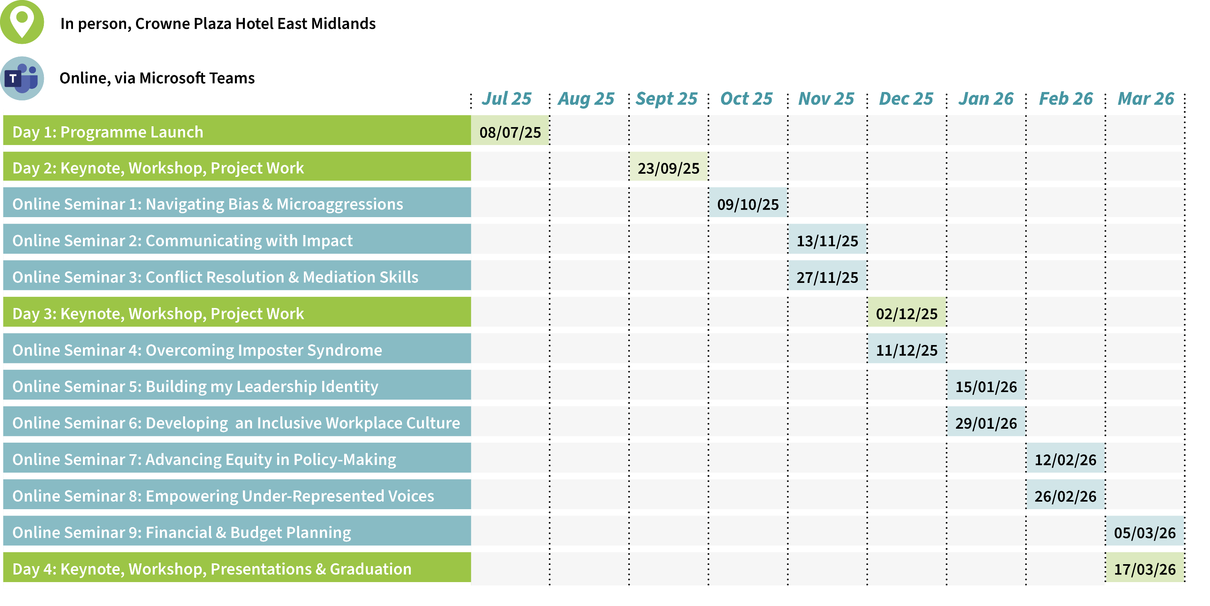
Programme Timeline

Slide 18
Programme Leadership Competencies
The Beyond Barriers programme is built upon a set of qualities recognised as most important for our current and future leaders in the East Midlands region.
These qualities include:
01 07
Demonstrating the capacity to transition from operational to strategic decision-making.
Demonstrating expertise in managing conflicts constructively and mediating between colleagues.
02 08
Proficiency in aligning objectives with organisational priorities and broader policy frameworks.
Communicating with clarity, confidence, and impact across diverse audiences.
03 09
Showing effectiveness in leading organisational change and fostering innovative practices.
Identifying and mitigating biases to ensure fairness in leadership practices.
04 10
Possessing the ability to influence key stakeholders effectively, even in the absence of formal authority.
Committing to addressing microaggressions and promoting equity within the organisation.
05 11
Preparing thoroughly for challenging interview scenarios and articulating leadership competencies.
Cultivating an inclusive workplace culture through cultural competence.
06 12
Maintaining awareness of emotional triggers and their impact on leadership behaviours.
Empowering underrepresented voices and fosters allyship within the leadership framework

Slide 19
Further
communication and
guidance will be sent
by email

Slide 20
Refreshment Break

Slide 21
Beyond Barriers Mentoring arrangements 2025
Kate Mckenna
Notes:
Introduce me and Hayley
Closed captions/cameras off or on when presenting
Break out rooms
Use the chat
Not recording
Second session is following the beyond barriers launch event on July 8th

Slide 22
Notes:
The RIIA plan overview

Slide 23
Theme | Activity/Action | Progress so far
B.5.1 Implementation of the DfE agency rules | Implement national agreements and phase-out the regional agency MoC. | The regional CS HR leads group has been active in this area and will continue to do so. The next meeting is on 6th May.
B.5.2 Address the shortage in specialist role by: Auditing strategic jobs roles in children's services Create promotional resources to support local recruitment | Coordinated recruitment and awareness strategies across authorities to attract diverse candidates, including overseas workers, for specialist roles in children's services, while also running public campaigns to build trust and understanding of various roles like social work and residential childcare | The survey is completed, and a draft report with recommendations has been shared. Two regional workforce development group meetings are scheduled to review the survey outcome and plan regional activities. SDSA is rebranding the old regional sector-led improvement website to EastMidlandsRIIA.org.uk. This is likely to be completed in the summer. One feature we aim to introduce is a learning hub, allowing LAs to share learning resources, both upload and download, from a searchable portal. This regional WFD group will play a significant role in developing this hub.
B.5.3 Develop high quality learning opportunities and resources for key areas of work and job roles | ​Consistent, high-quality training and learning opportunities across the region for all a wide range of job roles and work areas.
B.5.4 Establish mentoring facility for middle leaders, especially new in role | ​A pool of mentors with aims to enhancing the leadership skills, boosting confidence, and facilitating mentees transition into effective leadership roles. | A draft mentoring scheme guide has been shared. We will develop regional protocols to support cross-LA mentoring. There is a suggestion to provide mentoring training to increase the pool of mentors regionally. The workforce development group will review it.
B.5.5 Establish a regional working group to map and improve Front Door services | Peer learning and support to improve Front Door services | We have created the Front Door Services Group, which is leading this work separately. They have agreed to work as a Community of Practice and meet quarterly.
Notes:
WFD priorities and B.5.4 is where this is located
We are piloting the draft regional programme with you as mentors on the Beyond Barriers programme
We welcome your views on WWW/EBI

Slide 24
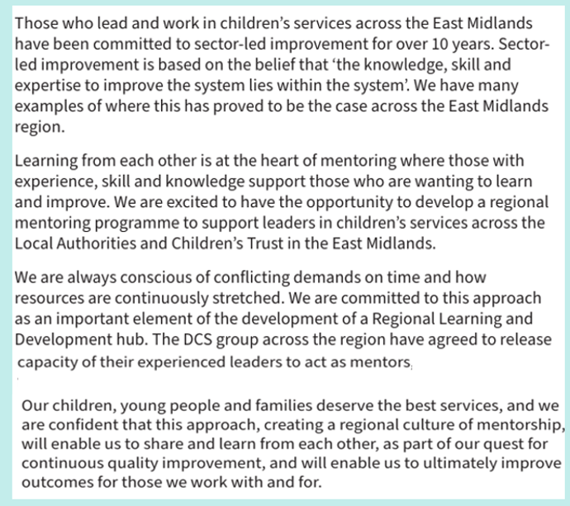

Slide 25
Where mentoring fits on the continuum of support
Coaching and mentoring sit on a push/pull continuum of impactful support. While there are similarities between coaching and mentoring, there are subtle differences.
Notes:
We have developed a draft guidance document that we will send to you
Either before or just after session 2
Coaching and mentoring continuum (this is in the guidance document)
Mentoring = push
Coaching = pull
Coaching and mentoring use many of the same skills. The main difference is who is the mentor – a qualified coach or a skilled mentor with a shared experience with the mentee

Slide 26
Benefits of mentoring
For the mentee
For the mentor
Having an opportunity to work alongside a mentor who has a shared lived or professional experience, context, situation or who has knowledge about an area that you are seeking to gain a greater understanding of, can be a very powerful personal and professional development opportunity. Benefits for mentees include, but not exclusively:
Supporting transition into a new role.
Gaining knowledge and learning from the experience of others.
Career development.
Managing professional relationships.
Developing leadership skills.
Improving confidence.
Supporting wellbeing.
Improving performance.
Managing competing priorities and work pressures.
There are also multiple benefits of being a mentor, including but not exclusively:
Supporting succession planning.
Building leadership skills.
Gaining a deeper value and understanding of equality, diversity, inclusion, equity and social justice.
Giving back and supporting others.
Understanding your profession on a deeper level and updating your knowledge.
Enhancing communication skills including intentional listening and questioning for understanding.
Personal growth and development.
Making a difference in someone's life.
Network building.
Notes:
Mentoring is a win-win activity.
This is why it is a valuable use of your time and that of your mentee.
It is ‘business of today’ focussed not additional
(this is in the guidance document)

Slide 27
Roles and Responsibilities
It is expected that Mentees will:
It is expected that Mentors will:
Take responsibility for managing your own development.
Set clear, realistic objectives and initiate learning and development activities.
Be responsible for scheduling all meetings and rescheduling them if needed.
Take responsibility for setting meeting agendas.
Be open to feedback from your mentor and receptive to new ideas.
Show consideration for your mentor’s time.
Adhere to confidentiality of the mentoring partnership.
Maintain the commitment to the mentoring partnership – the frequency, structure and length will be discussed and agreed with the mentor, but it’s typically 4-6 sessions over 12 months, with learning and development activities between meetings.
Motivate and encourage your mentee to take responsibility for their own learning and development activities.
Help identify learning and who else can provide support.
Provide constructive feedback and act as a sounding board for ideas.
Challenge your mentee to take a broad perspective.
Use listening skills and a facilitative approach to increase mentee’s awareness of strengths and weaknesses.
Adhere to confidentiality of mentoring partnership.
Provide advice where prudent and appropriate.
Maintain commitment to the mentoring partnership – the frequency, structure and length will be discussed and agreed with the mentee, but it’s typically 4-6 sessions over 12 months, with learning and development activities in between.

Slide 28
4/6 sessions over a 12-month period

Slide 29
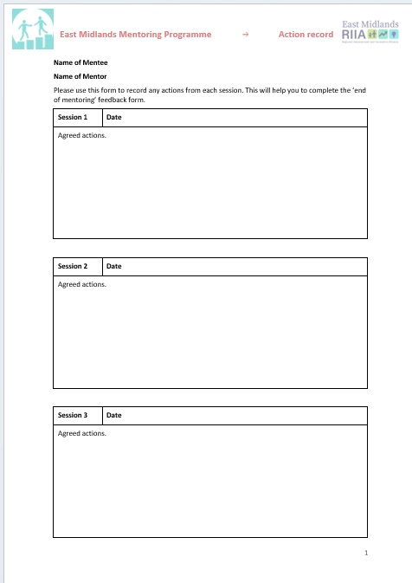
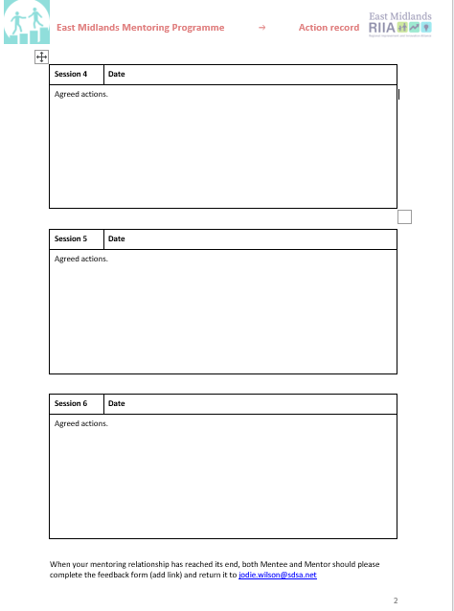

Slide 30
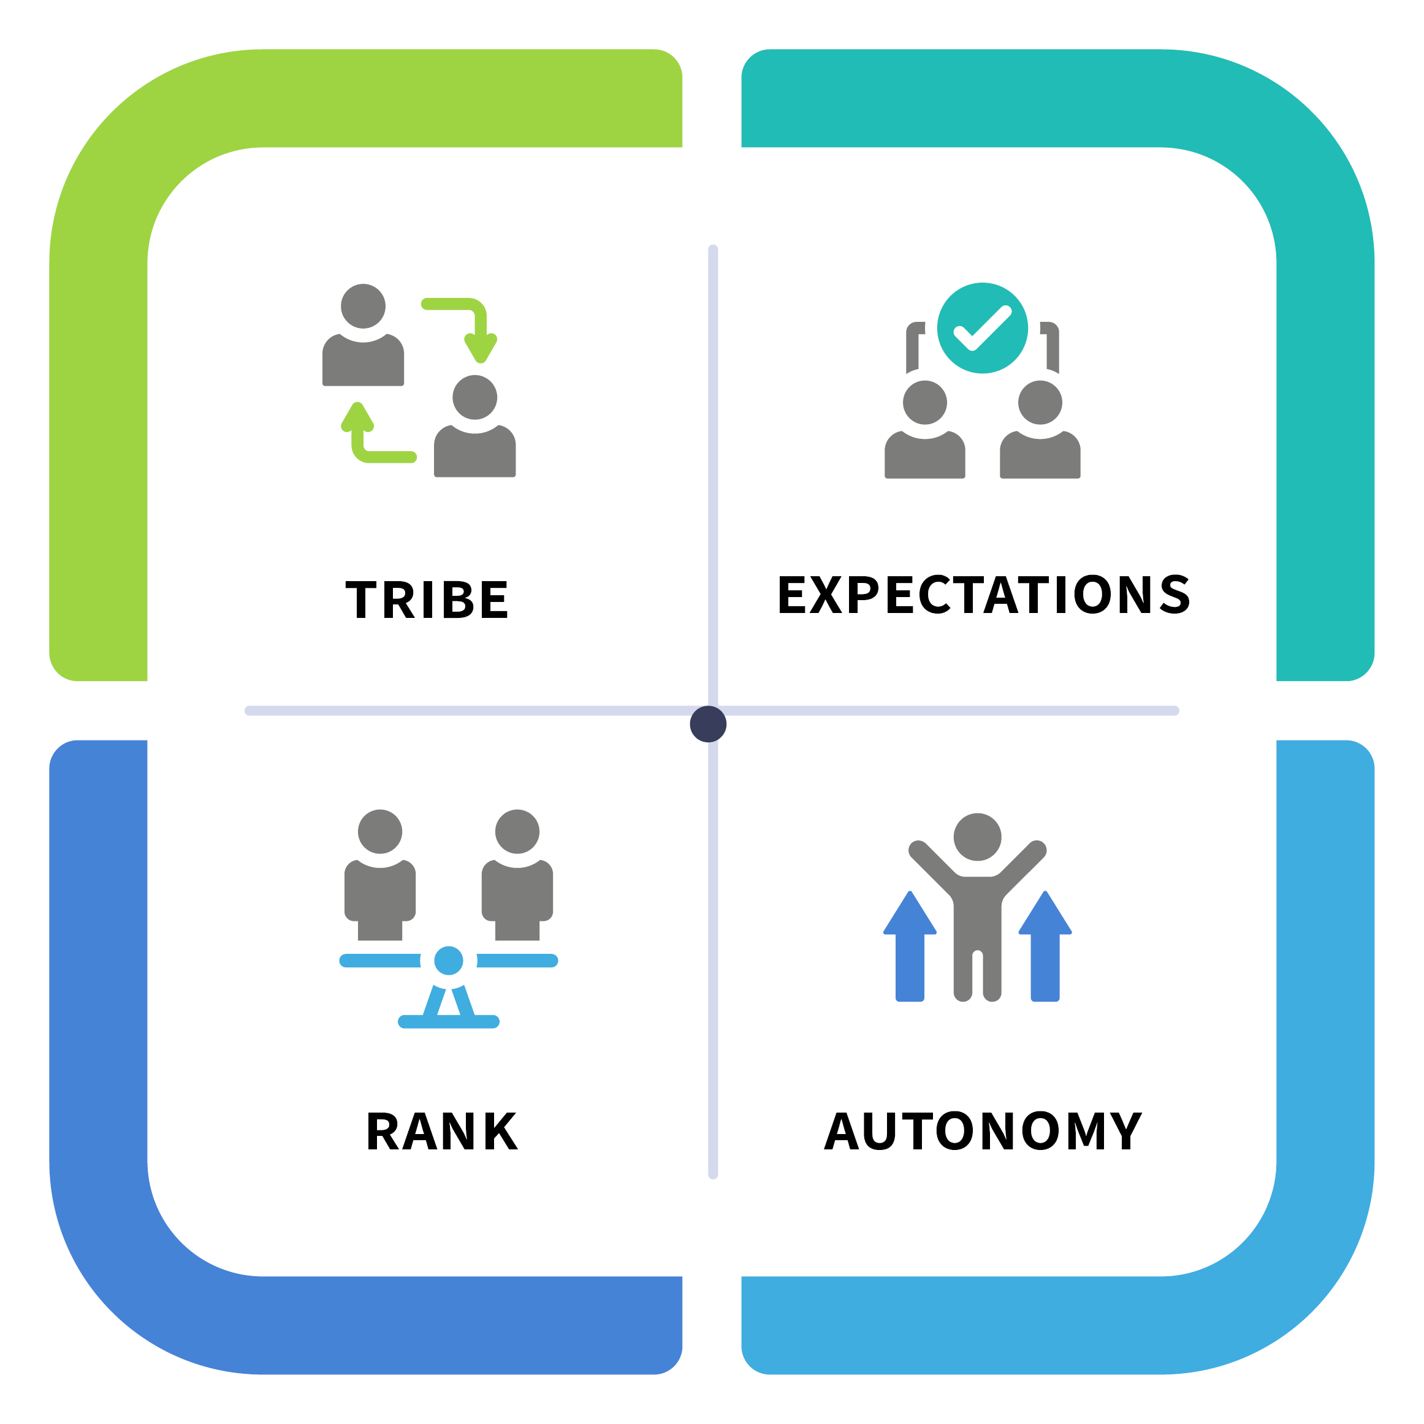
Building Trust and Rapport
Both mentor and mentee need to be committed to the mentoring relationship. Consider how you can ensure that you can give your full attention during a session and how you can prepare for each conversation:
Think about where you will meet to make sure you will not be interrupted either in person or by ‘pop up’ notifications and phone/text messages.
Try, if possible, to allow time before and after each conversation to prepare and reflect on your experience.
Check in at the start of each conversation that both are comfortable and able to give their full attention to the conversation.

Slide 32
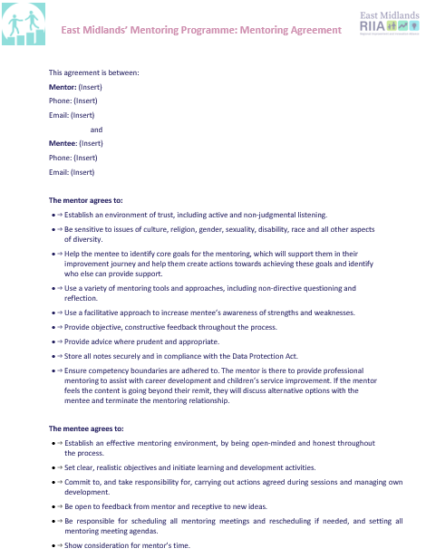
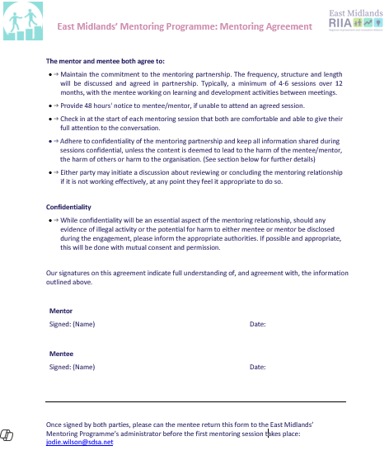
We invite you to spend some time in your mentoring pair to look at this agreement, sign it and return it to Jodie Wilson.

Slide 33
Introduction to the Group Task Project Pete Chilvers

Slide 34
What the Group Task Project isn’t
Misconceptions
Not an assessment task
No ‘right’ answer
Not pre-determined
Not stress-inducing
The project is not being evaluated as an academic task
There are no definitive answers, creativity is encouraged
Participants will shape the project rather than follow a fixed plan
Our hope is for the project to be a positive experience, and not stress-inducing

Slide 35
What the Group Task can be
A collaborative opportunity
Work with a mixed group of colleagues on shared interests-
the process is almost as important as the product
Creating practical resources
Develop tools and strategies that are beneficial to others in the programme and the region’s LA’s
Engage and enjoy
Emphasis on having fun while learning and collaborating

Slide 36
Group Task selection
Designing a diversity recruitment strategy
Objective
Identify barriers and design strategies to attract and retain under-represented talent
Improving community engagement
Objective
Identify Opportunities for sustained engagement that supports diverse communities and builds long-term trust
Participants
Shareen Bashir
Sameer Patel
Mo Bham
Nikki Taylor
Sabina Talib
Promoting inclusive leadership practices
Objective
Investigate leadership behaviours that create psychologically -safe teams where all voices contribute
Participants
Shaheen Parekh
Sam Singh
Rochelle Wallace
Aneeta Hulait
Oladuti Olusesi
Advocacy for EDI in leadership
Participants
Belinda Rose
Tinashe Zirereza
Natasha Mann
Sam Merry
Phillipa Michael
Creating a mentoring or sponsorship programme
Measuring EDI impact
Objective
Designing a structure to nurture diverse talent into leadership roles
Objective
Investigate EDI metrics to evaluate and report progress effectively
Objective
Explore techniques for creating champions of equity and inclusion
Participants
Sonia Burton
Liz White
Temitope Peter
Sandra Kamchira
Candice Montague York
Participants
Jacquie Thomas
Roxanne Njopa-Kaba
Jeena Chauhan
Ella Mackie
Tendai Holloway
Participants
Jasraj Sanghera
Priscilla Gono
Yateen Makwana
Paulette Wright
Leena Warden

Slide 37
Project Timeline
Project timeline
TODAY
Today
Initial group meeting and set-up
Initial Group Meeting and set up
1
2
3
4
5
6
Meet your group members
Arrange group communication
Set up file sharing
Nominate your Admin contact
Discuss initial thoughts and ideas
Agree your next steps
Establish connections and set the tone for collaboration
Choose effective communication tools, e.g. TEAMs, WhatsApp, other?
Agree upon a shared file space using platforms like Google Drive or Dropbox
Select a group member to coordinate communications and manage schedules
Engage in open discussions to share insights and start to spark innovation
Agree what each group member will do as their first tasks for the project

Slide 38
Project Timeline
Project timeline
TDAY
23rd September 2025- In-person event
Project Development
Initial Group Meeting and set up
1
Collaborative Session
Spend 90 minutes refining ideas from summer.
Consider a template/aide (provided) for December session.
2
Group Planning
Agree your group plan for December session.
We will keep in touch with all groups via your admin person throughout the programme

Slide 39
Project Timeline
Project timeline
TDAY
2nd December 2025- In person event
Finalising your project
Initial Group Meeting and set up
1
Presentations
Present the emerging shape of your project to the rest of the cohort (5-10 mins)
Give feedback to others
Consider a template and suggestions (provided) for the final March session
Create any products, posters, artefacts etc
2
Adjustments
Reflect on the feedback and suggestions provided
Possibly adjust your group project, as you choose
Plan how/who will make a final presentation
We will keep in touch with all groups via your admin person throughout the programme

Slide 40
Project Timeline
Project timeline
TDAY
17th March 2026- Final in-person event
Still subject to confirmation …….
Initial Group Meeting and set up
We plan to invite your DCS’s and other significant / relevant senior colleagues to the final event
The event will include:
Project Market place
Each group will have the microphone for 5 mins each to summarise their project outcomes and learning
Each group will have a display-point at the marketplace and all participants and visitors will circulate for 45-60 minutes
All of the final products and artefacts from each project will be collected and produced into a ‘keepsake’ from the programme.
All participants will receive all projects

Slide 41
Project Timeline
What success looks like
TDAY
Reflective learning shown in the final presentation
Clarity of purpose and target audience
Practical value and usability of the final outputs
Collaborative working that reflects inclusive leadership principles
Insight and evidence-informed thinking on EDI issues
Creativity and innovation in approach
Initial Group Meeting and set up
Success

Slide 42
Questions & Answers

Slide 43
Lunch & Close
2pm – Mentor Session 2- (Mentors only)
Thank you and
safe onward Journey

