Slide 1
Visibility in Leadership Network
Lived Experiences
Presented by Jeena & Khalid
Diversity in Children’s Services Leadership Teams

Slide 2
Khalid to add:
The aim of the group & its journey so far….
How many members
Objective
Meeting how often
Discussions so far
Diversity in Children’s Services Leadership Teams

Slide 3
Real Life lived experiences:
Please:
Do not speculate
Recognise the courage it takes to share
You will be asked to reflect after these
Diversity in Children’s Services Leadership Teams

Slide 4
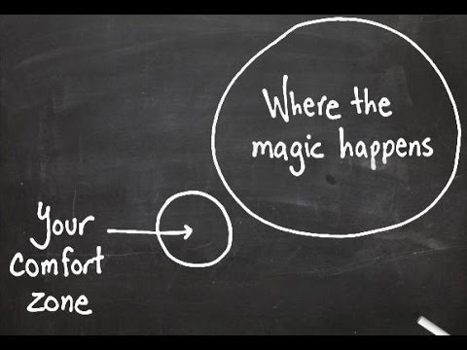

Slide 5
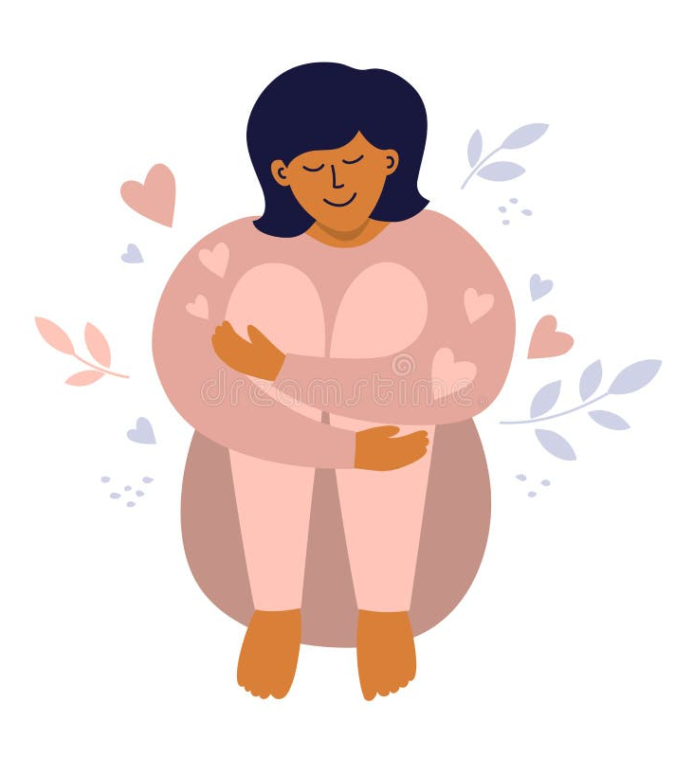
TAKE CARE OF YOURSELF

Slide 6
Lived experience 1
I am a Black British male of Afro Caribbean heritage; my current role is that of a team manager in children’s services. Originally from South where the majority of my working experiences have been predominantly working in Youth Services in London but in the last 15 years in the North and Midlands. …..
Diversity in Children’s Services Leadership Teams

Slide 7
Lived experience 2
I have spent 25 years in local government, 11 of which have been in senior management roles, including 7 years in Children’s Services. I am a proud man of Black African heritage, a father to four mixed-heritage children, and happily married. ….
Diversity in Children’s Services Leadership Teams

Slide 8
Lived experience 3
Belonging!
Diversity in Children’s Services Leadership Teams

Slide 9
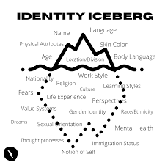
Be curious, be brave, take an interest….

Slide 10
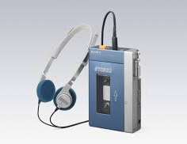
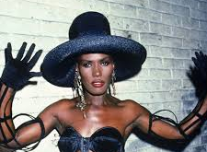
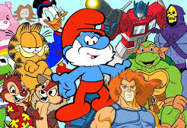
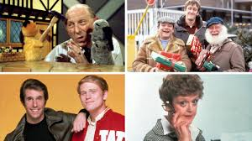
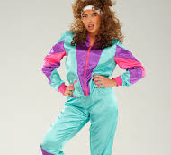
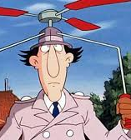
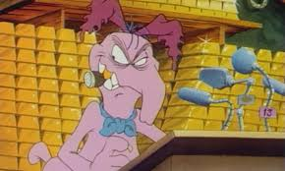

Slide 11
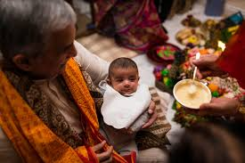
Jeenakumari Chauhan >
Jeena Chauhan
Diversity in Children’s Services Leadership Teams

Slide 12
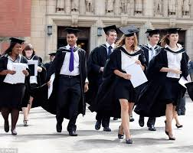
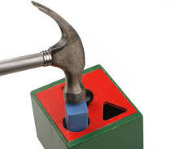
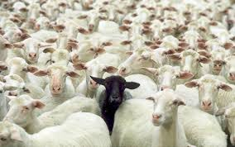

Slide 13
Be Brave
Be curious
Leaders of Action
Equity Ambassadors
Choose to -shift or shatter
See and nurture the potential
Explore the iceberg
Small acts or actions matter
Be champions of Hope
We all want to belong

Slide 14
How are you feeling?
What resonated with you?
What made you feel uncomfortable?
What surprised you?
What one thing will you do within the next 10 days as direct result of what you have heard this morning?

