Slide 1



THE IMPORTANCE, PROGRESS AND CHALLENGES OF RACE EQUITY WORK IN LINCOLNSHIRE

Slide 2


TODAYS SESSION
01
02
03
04
05
ED - MOTIVATION AND NEED
KIM - EXPERIENCE
ELA - THE WHAT
CAROLYN / CHRIS- LEADERSHIP
OVER TO YOU -

Slide 3
Microsoft Forms Interactive Quiz

Slide 4


WHY IS THIS ESSENTIAL?
  LINCOLNSHIRE DEMOGRAPHICS
  RURAL EXPERIENCE
  CHILDREN AND LCC NEED DIVERSITY
  ALLYSHIP
ED

Slide 5

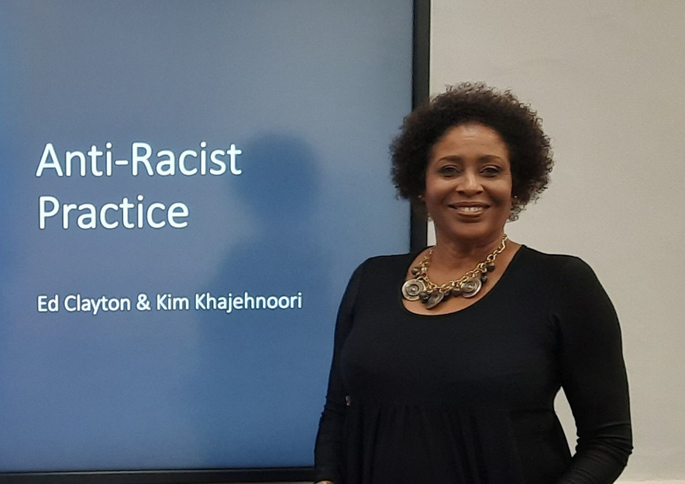

2017
STARTED WORK AT LCC
2020
BLACK LIVES MATTER
2023
MY PRIDE AND ANTI-RACIST ACTIVISM
2025
MY LIVED EXPERIENCE
THE CHALLENGE CONTINUES
KIM

Slide 6




VOICE OF COLLEAGUES

Slide 7





DEVELOPMENTAL WORKSHOPS
SOCIAL CARE RACE EQUALITY STANDARD
THE WORK
DIGITAL & MEDIA
ADULTS & CHILDREN COLLABORATION
ELA

Slide 8

LEADERSHIP
  Social Work England Standards
  Reach out personally
  Amplify and provide space
  Zero tolerance
  Making reflective space for values and activism (as PSW)
  Humility
CAROLYN

Slide 9


YOUR THOUGHTS PLEASE
  HOW CAN LINCOLNSHIRE CONTINUE TO MAKE PROGRESS ?
  WHAT ELSE SHOULD LEADERSHIP BE DOING?
  WHAT WORKS IN ATTRACTING DIVERSE TALENT TO LOCAL AUTHORITIES?
  WHAT HAVE YOU HEARD FROM THE SESSION THAT RESONATES WITH YOU / YOUR WORKPLACE

Slide 10
Links to Podcasts
With Ed and Ela recorded considering Anti-Racist Practice in Lincolnshire.
Its All About People, Anti-Racist Practice Part 1 https://www.podbean.com/ew/pb-3vnr2-16eb7a9
Its All About People, Anti-Racist Practice Part 2 https://www.podbean.com/ew/pb-q58zw-1766ae2

Slide 11


