Slide 1
Regional EDI Conference
Saj Zafar
CEO & Founder
www.instituteforchange.net

Slide 2
Hi I’m Saj
Psychologist , Global -Award winning Leadership Coach, Certified CQ Intelligence Coach, international Speaker & Author
Made History – First youngest Asian Muslim woman to become a Prison Governor
Central Government – Prison reform , Grenfell, Windrush
20 years of senior leadership roles in local & central government business management –change agent driving culture /business change for failing institutions
IFC Training & Consulting – Inclusive leadership, CQ Intelligence
LeadHERship™ Academy -Mission Impacting one million women to step into LeadHERship excellence

Slide 3
Every day, children fall through the cracks — not because they lack potential, but because the systems around them fail to see them. And the same is true for too many leaders from under-represented backgrounds.

Slide 4
Born in Kashmir.
Raised in South Yorkshire.
Made in Prisons

Slide 5
Some people spend their whole lives searching for their purpose. Mine came as a younger version of me — the girl who needed rescuing.

Slide 6
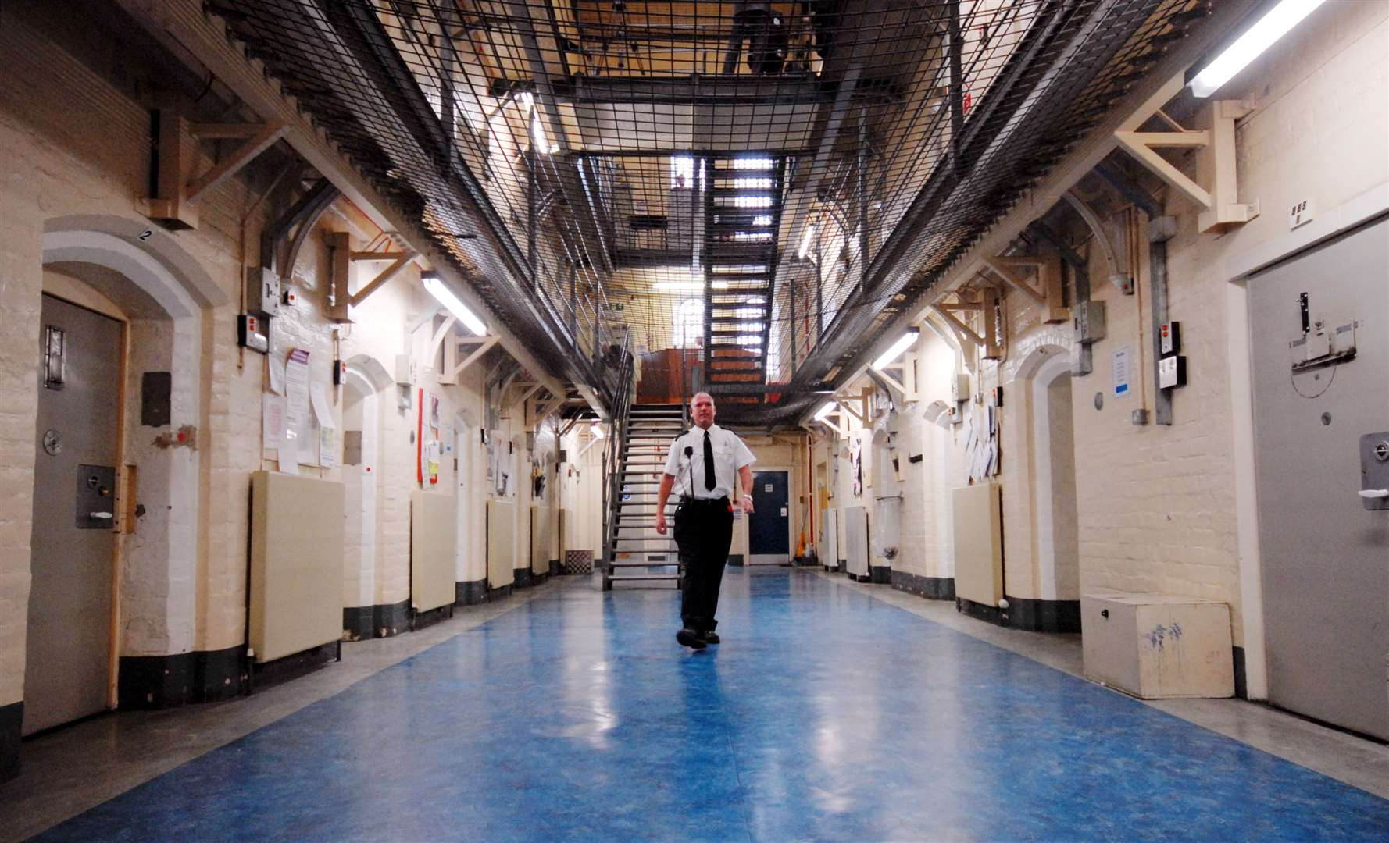
Leadership Lesson One
Learning to Thrive in Spaces That Weren’t Designed for Us.

Slide 7
Leadership Lesson Two
Leadership — At Its Best, Worst, and Ugliest

Slide 8
Leadership Lesson Three
You weren’t made to Fit In. You were Born to Stand Out.

Slide 9
Leadership Lesson Four
The Opposite of Courage Isn’t Cowardice. It’s Conformity.

Slide 10
Leadership lesson Five
People Don’t Buy Into Your Positional Authority — They Buy Into Brand You

Slide 11
Leadership Lesson Six
Your legacy is what you impress and leave behind

Slide 12
Leadership Lesson Seven
Great Leaders know when to exit

Slide 13
Thank you
Linked In
www.instituteforchange.net
www.leadhershipacademy.co.uk

